Slide 1
Introduction to J2EE

Slide 2

Objectives
At the end of this session, you will be able to,
  Define J2EE
  Describe the J2EE tiers
  Describe Enterprise Application
  Describe J2EE Components
  Describe J2EE Roles

Slide 3

Agenda
  Following topics are covered during the session,
  J2EE Overview
  J2EE Definition
  Need for J2EE
  Enterprise Application
  J2EE architecture
  J2EE Specification
  J2EE Components
  J2EE Roles

Slide 4
Introduction

Slide 5
J2EE Origin
Sun Microsystems, together with partners such as IBM, designed J2EE to define a multi-tier architecture for developing enterprise information systems (EIS) to answer the needs from the industry.
Goals:
  reduce the cost and complexity of development
  allow J2EE applications to be rapidly deployed and easily enhanced

Slide 6
What is J2EE?
Java 2 Platform, Enterprise Edition (J2EE) is an open, standard-based, development and deployment platform for building n-tier, web-based, server-centric, and component-based enterprise applications.
The J2EE platform consists of a set of services, APIs, and protocols that provide the functionality for developing multitier, Web-based applications.
CONFIDENTIAL© Copyright 2008 Tech Mahindra Limited

Slide 7
J2EE Tiers

Slide 8
Evolution of Enterprise Application Framework
Single tier
Two tier
Three tier (HTML browser and Web server)
Proprietary application server
Standard application server
Notes:
The evolution of enterprise application framework starts from single-tier mainframe based model in the beginning, moved to first phase of distributed framework, two-tier client server model, then three tier model.
Within the three-tier model, there are two communication models. First one is based on RPC (Remote Procedure Call) model in which non-object-based procedures are invoked by the client. The other model incorporates the concept of object in which remote object is accessed by the client.
When the Internet took off, the three tier model takes a very radical transformation in which HTML browser talks to a Web server, which then talks to backend database or enterprise information systems.
The next two phases are advent of the concept of application server, first, app server based on proprietary architecture and API and the next phase is where we are today with open standard based app server architecture, which is what J2EE is all about.

Slide 9
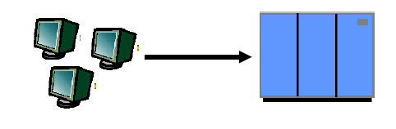
Single-Tier ( Mainframe Based)
Dumb terminals are directly connected to mainframe
Centralized model (as opposed distributed model)
Presentation, business logic, and data access are intertwined in one monolithic mainframe application
Notes:
In the beginning of computing era, the model is pretty much a single tier model in which dumb terminals are directly connected to a mainframe. Here the mainframe is centralized point of computing intelligence in which presentation, business logic, and data access are all intertwined in a single monolithic mainframe application.
Single-Tier: Pros & Cons
• Pros:
● No client side management is required
● Data consistency is easy to achieve
• Cons:
● Functionality (presentation, data model, business logic) intertwined, difficult for updates and maintenance and code reuse
In a single tier model, because the clients are dumb terminals and do not have any processing logic what so ever, there is no client side management required. Also because the data access logic is in complete control of the mainframe application, the data consistency is easy to achieve.
Now the negative side of single tier model is that there is no separation among presentation, business logic, and data access. This doesn't facilitate code re-use because all functionality is mixed together. Changing data or business logic may affect every part of the application, making changes (for example, adding new functionality or bug fixes) difficult task.

Slide 10
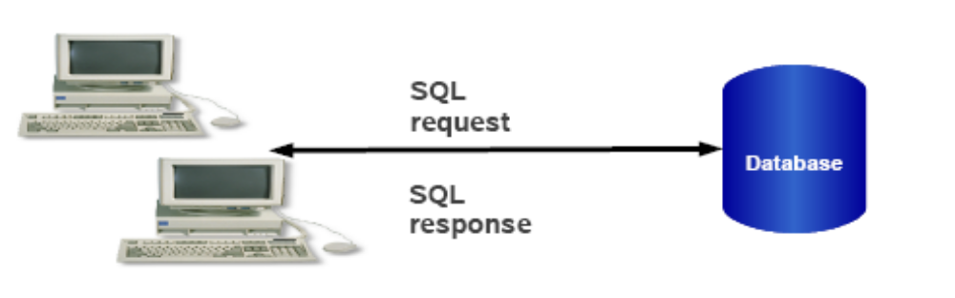
Two-Tier
Fat clients talking to back end database
SQL queries sent, raw data returned
Presentation, Business logic and Data Model processing logic in client application
Notes:
The next evolution phase is two-tier model. The two tier model appears along with the advent of personal computer, which was increasingly used as client platform of choice replacing dumb terminals.
In two-tier model, fat clients are talking to backend database by using some database access protocol such as SQL.
The clients are called “fat” clients because the clients have to maintain presentation logic, business logic, and have to have detailed understanding on data model of the backend data and how to access it.
Two-Tier: Pros and Cons
• Pro:
● DB product independence (compared to single-tier model)
• Cons:
● Presentation, data model, business logic are intertwined (at client side), difficult for updates and maintenance
● Data Model is “tightly coupled” to every client: If DB Schema changes, all clients break
● Updates have to be deployed to all clients making System maintenance nightmare
● DB connection for every client, thus difficult to scale
● Raw data transferred to client for processing causes high network traffic
The advantage of using two-tier model is that it provides database independence and database access protocol is standard SQL language
compared to single-tier model.
Yet, it has very significant disadvantages as well. First, the presentation, business logic and data model are now intertwined, this time, at the client side, thus suffers same problem of difficult maintenance and updates. Second, because the data model of the server also has to be maintained at the client, every time there is a data model change, for example, a schema change, then all the clients need to be updated. This could be a very serious deficiency if the number of clients are in the range of thousands even in the range of hundreds. Now since each client has to have a database connection, it would be rather difficult to scale in that it is not possible to provide “connection pooling”scheme., which is typical mechanism for supporting scalability. Because the data is in the form of raw data, there could be very high demand on network bandwidth.

Slide 11
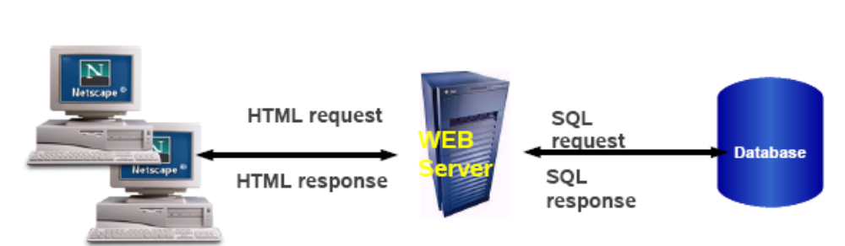
Three-Tier
Thinner client: business & data model separated from presentation
  Business logic and data access logic reside in middle tier server while client handles presentation
Middle tier server is now required to handle system services
  Concurrency control, threading, transaction, security, persistence, multiplexing, performance, etc.
Notes:
The “difficult to upgrade clients” problem of two-tier model triggers the advent of next one, three-tier model.
The most distinguishing characteristic of three tier model is that now there is a separation between presentation logic from the other two. That is, the presentation logic is handled at the client while business and data access logic are handled at the middle tier server. In this sense, the clients of three tier model is thinner than the ones in two-tier model. And the changes of business logic and data model can be done more flexibly than two-tier model because the only place the changes need to be reflected are at the middle-tier server not at the clients.
The three tier model, however, introduces an interesting problem of its own. Now because the middle-tier server receives service requests from many clients at the same time, the middle-tier now has to deal with various system level issues such as concurrency control, threading, transaction, security, persistence, multiplexing, performance, and so on.
Now as mentioned before, the three tier model can be further divided into RPC-based and Remote object based. In RPC based model, the clients and the middle-tier server are more tightly coupled than the object model because they have to agree upon on the implementation level (rather than interface level of remote object based model.)
So the benefit of using three-tier model over two-tier model is again the business logic and data model can be more easily changed.
Now the downside of the three-tier model is that now the middle-tier server has to deal with complex system level issues as mentioned in the previous slide. And compared to object-based three tier model, it is more tightly coupled because change of implementation on either side might require change on the other. And since it is not really object-mode based, the code is not reusable.

Slide 12
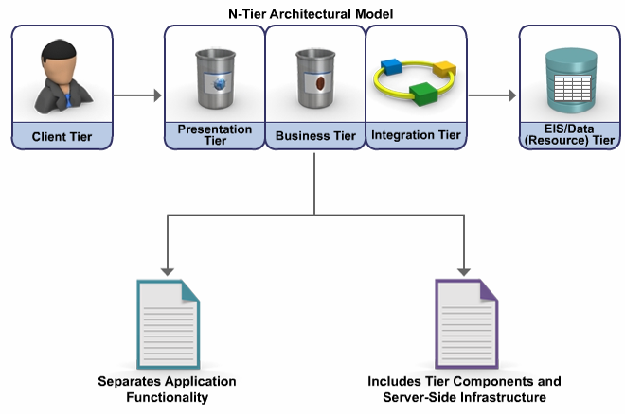
N-Tier Architecture
Notes:
A J2EE enterprise application typically implements an N-tier architecture model. The N-tier architecture model describes any type of application architecture that programmatically separates application functionality across three or more tiers. The components in each tier, as well as the server-side infrastructure that is available in each tier, are generally uniquely suited to a particular task.
Consider an example. The presentation tier components tier components and runtime infrastructure for an application that interacts with browser clients over the internet must be able to process HTTP requests. It should also generate responses that are formatted using HTML.
Similarly, the integration tier runtime infrastructure and associated components might support functionality for representing a back-end data store as an object model. The integration tier components synchronize changes in the data model across the set of data resources that are provided by the enterprise information system (EIS).
Programmatic interfaces typically define the boundaries between tiers. The interfaces are contracts that define the functionality available from a tier and the data elements passed between the tiers. These interfaces must be well designed and stable within the system.
Based on their area of expertise, separate programming teams are responsible for developing and maintaining application components in each tier. For example, developers specializing in the creation of user interfaces create presentation-tier components, while developers having specific knowledge about a business domain develop the related business-tier components.

Slide 13
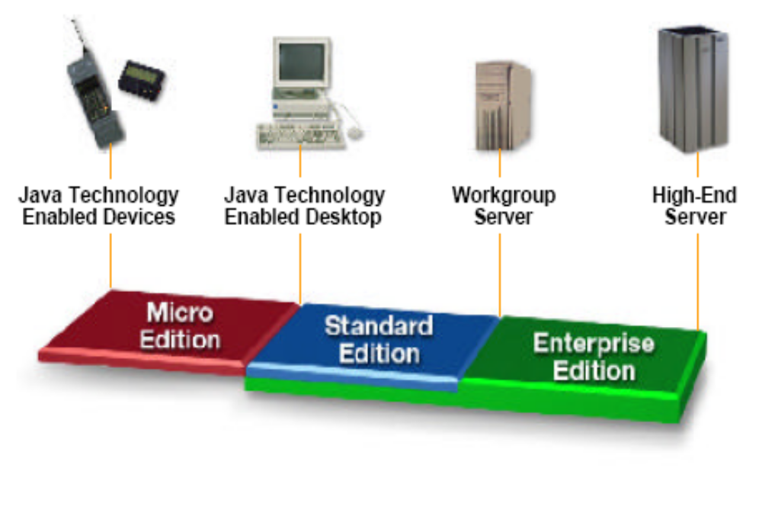
J2EE and Java Technology Platform
Notes:
The J2EE platform fits with the other java technology platforms like Micro edition and standard edition. The micro edition can be integrated with the java technology enabled devices, and the standard edition fits with the java technology enabled desktops. Similarly, the enterprise edition can be integrated with both workgroup and high-end servers. You can use J2EE technology to develop distributed enterprise-scale applications that are quite complex and resource intensive.

Slide 14
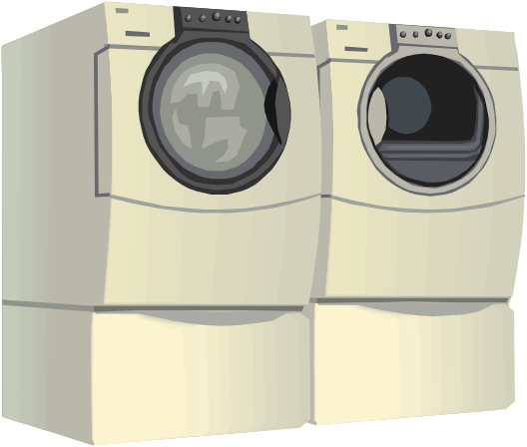

Java Micro Edition
Java Platform, Micro Edition (Java ME) is a collection of technologies and specifications to create a platform that fits the requirements for mobile devices such as
      consumer products,
      embedded devices,
      and advanced mobile devices.
It is a collection of technologies and specifications that can be combined to create a complete Java runtime environment specifically to fit the requirements of a particular device

Slide 15

Java Standard Edition
Java Platform, Standard Edition or Java SE is a widely used platform for programming in the Java language.
It is the Java Platform used to deploy portable applications for general use.
In practical terms, Java SE consists of a virtual machine, which must be used to run Java programs, together with a set of libraries (or "packages") needed to allow the use of file systems networks, graphical interfaces, and so on, from within those programs.
It is use for stand alone desktop application

Slide 16
Why J2EE?
The downside of the three tier architecture is that the middle-tier components where the business logic is written had to provide other services also like concurrency control, threading, transaction, security, persistence, performance, and so on.
How to solve this problem?
The solution is to come up with an architecture or framework where the common container which can be shared among all applications provide system services mentioned above.
What is the solution?
Use "component and container" model in which container provides system services in a well-defined and as industry standard
J2EE provides the solution
The standard specification defines the contract of the component and container model in a well-defined and in an industry standard.
CONFIDENTIAL© Copyright 2008 Tech Mahindra Limited
Notes:
The downside of the three tier architecture is that the middle-tier components where the business logic is written had to provide other services also like concurrency control, threading, transaction, security, persistence, performance, and so on.

Slide 17
Enterprise Application
A typical enterprise Application is made up of
  Presentation logic
  Business logic
  Data Access Logic
  System Services
CONFIDENTIAL© Copyright 2008 Tech Mahindra Limited
Notes:
The presentation logic deals with how to present information to the end-users. The business logic includes the business logic of the application. And the data access logic deals with accessing data in the back-end database. The system services includes security, caching, logging, transaction, and other services that typical enterprise application would use.

Slide 18
Enterprise Application
Features of Enterprise applications
  Scalability
  Availability(24 * 7 without any downtime)
  Maintainability
  Reliable
  Speed/Performance
  Multi-User
  Fault-Tolerant
  Secure
  Robust
  Distributed
  Transactional
  Vendor independent
  flexible

Slide 19
J2EE Platform and Architectures

Slide 20
J2EE Platform Architecture
Component
  A component is an application level software unit
  The J2EE platform supports the following types of components:
    Applets
    Application clients
    Web components
    Enterprise Java Beans (EJBs)
Container
  All J2EE components depend on the runtime support of a system-level entity called a container
  Containers provide components with services such as:
    Connection and Object pooling
    Security
    Transaction
    Deployment

Slide 21
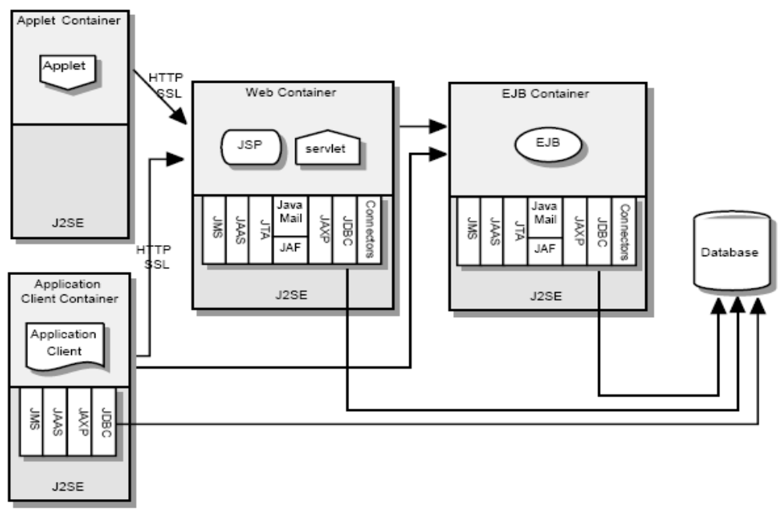
J2EE Platform Architecture
CONFIDENTIAL© Copyright 2008 Tech Mahindra Limited
Notes:
The required relationships of architectural elements of the J2EE platform are shown in the above figure. The containers, denoted by the separate rectangles, are J2EE runtime environments that provide required services to the application components represented in the upper half of the rectangle. The services provided are denoted by the boxes in the lower half of the rectangle. For example, the Application Client Container provides Java Messaging Service (JMS) APIs to Application Clients, as well as the other services represented.
A Web container "implements the web component contract of the J2EE architecture“
This contract specifies a runtime environment for web components that includes security, concurrency, , transaction, deployment, and other services. A web container provides the same services as a JSP container as well as a federated view of the Java EE (formerly J2EE) platform APIs. In web container only web application can run example Servlet and JSP . Apache Tomcat is a web container .
Application Server – A J2EE application server provides the facilities for executing Enterprise JavaBeans (EJBs).
Application servers provide EJB containers and web container for JSPs and servlets,
Application = Web Container + EJB Container
Few Application Server
Weblogic by Bea
Web sphere by IBM
JBoss by Red Hat
J2ee Server by Sun
Glassfish by Sun

Slide 22
J2EE Specifications

Slide 23
J2EE 5.0 Specifications
Web Services Technologies
  Java API for XML-Based Web Services(JAX-WS) 2.0
  Java API for XML-Based RPC (JAX-RPC)1.1
Web Application Technologies
  Java Server Faces 1.2
  Java Server Pages 2.1
  JSTL
  Java Servlet 2.5
Enterprise Application Technologies
  Enterprise Java Beans 3.0
  Java Mail
  Java Message Service API
  Java Persistence API
  Java Transaction API(JTA)
  Java Beans Activation Framework(JAF) 1.1

Slide 24
Future versions …. Java EE 6
Web Services Technologies
  Java API for XML-Based Web Services(JAX-WS) 2.2
  Java Architecture for XML Binding(JAXB) 2.2
  Java API for XML Messaging 1.3
  Java API for XML Registries(JAXR) 1.0
Web Application Technologies
  Java Servlet 3.0
  Java Server Faces 2.0
  Java Server Pages 2.2/Expression Language 2.2
  JSTL 1.2
Enterprise Application Technologies
  Dependency Injection for Java 1.0
  Bean Validation 1.0
  EJB 3.1
  Java Persistence 2.0
  JMS API 1.1

Slide 25
Future versions …. Java EE 6
  Java Mail 1.4
Management and Security Technologies
  Java Authorization Contract for Containers 1.3
  Java EE Application Deployment 1.2
  J2EE Management 1.1
Java EE –related Specs in Java SE
  JAXP 1.3
  JDBC 4.0
  Java Management Extension(JMX) 2.0
  Java Beans Activation Framework (JAF) 1.1

Slide 26
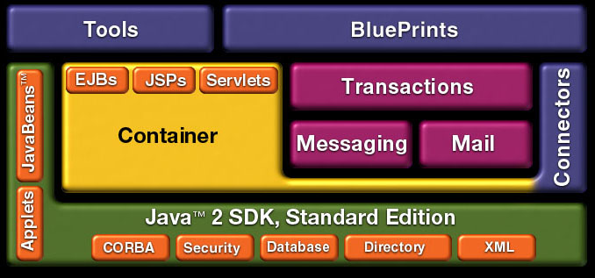
J2EE Stack
Notes:
This slide is another way to look at the platform.
We are providing Containers, or execution environments, for the fundamental component types: EJB, Servlets, JSP.
These components talk, via the container, to existing systems via the connectors.
We are firmly rooted on J2SE v 1.2
We provide tools to show how to build tools for the platform
Blueprints are our best practices guide to building apps on the platform.

Slide 27
J2EE Suite
Core Technology: Container infrastructure, language and environment support
Web Technology
  Java Servlets
  JavaServer Pages
  JavaServer Pages Standard Tag Library
Enterprise Java Bean (EJB) technology
  Session beans
  Entity beans
    Enterprise JavaBeans Query Language
  Message-driven beans

Slide 28
J2EE Suite (contd.)
XML Technology
  The Java API for XML Processing (JAXP)
  The Java API for XML-based RPC (JAX-RPC)
  SOAP with Attachments API for Java (SAAJ)
  The Java API for XML Registries (JAXR)
Platform services
  Security
  Transactions
  Resources
  Connectors
  Java Message Service

Slide 29
J2EE Communication Technologies
Internet protocols - TCP/IP HTTP 1.0 SSL 3.0
Remote Method Invocation protocols
Object Management Group protocols - JavaIDL RMI-IIOP
Messaging technologies - JMS, JavaMail
Data formats - HTML 3.2, Image Files, JAR, class files,XML
CONFIDENTIAL© Copyright 2008 Tech Mahindra Limited
Notes:
Web client : Browser that access resources located in the web tier( web pages written in HTML or XML,jsp or servlets) Protocol used :HTTP or HTTPS
Enterprise Java Bean Client :
Access one or more Enterprise Java Bean located on the Enterprise Java Bean Tier
Protocol used : Java Remote Method Protocol or Internet Inter-ORB Protocol
Enterprise Information System Client
Interface between the users and the resources located on the EIS Tier. Protocol used : proprietary to utilize resources such as DBMS and legacy data sources.
Multi-tier client
Use the Java Message Service to asynchronously communicate with other tiers.

Slide 30
J2EE Components

Slide 31

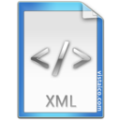
Web Components
Java content
  Servlet class
  JSP Pages
Deployment Descriptor
  Web.xml
JSP Pages
HTML Pages
WEB-INF
classes
lib
web.xml

Slide 32
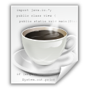
EJB Components
Java content
  Home Interface
  Business Interface
  Bean Class
Deployment Descriptor
  ejb-jar.xml
  weblogic-ejb-jar.xml
Home.class
Business.class
Bean.class
META-INF
ejb-jar.xml
weblogic-ejb-jar.xml

Slide 33


Enterprise Application
J2EE Components
  Web components
  Ejb components
  Utility jars
Deployment Descriptor
  application.xml
war file
jar file
META-INF
application.xml

Slide 34
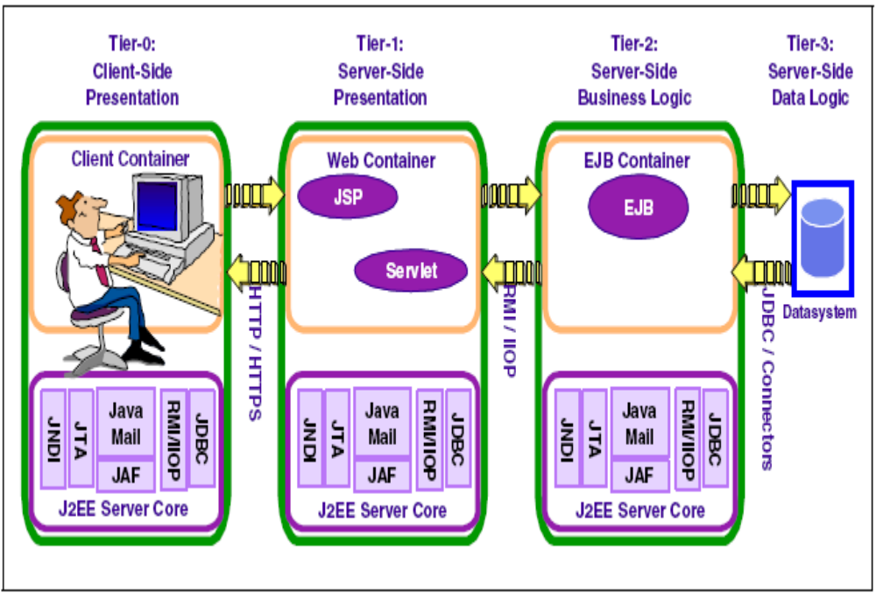
J2EE Runtime Architecture

Slide 35
J2EE Roles

Slide 36
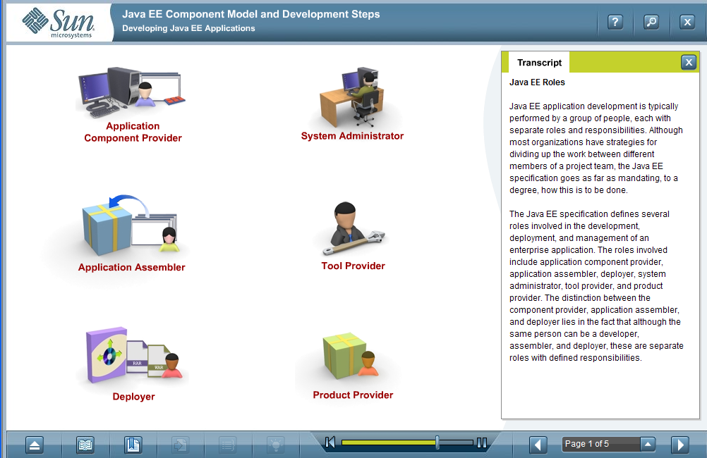
J2EE Roles
Notes:
J2EE application development is typically performed by a group of people, each with separate roles and responsibilities. Although most organizations have strategies for dividing up the work between different members of a project team, the J2EE specification goes as far as mandating, to a degree, how this is to be done.
The J2EE specification defines several roles involved in the development, deployment, and management of an enterprise application. The roles involved include application component provider, application assembler, deployer, system administrator, tool provider, and product provider. The distinction between the component, application assembler and deployer lies in the fact that although the same person can be a developer, assembler, and deployer, these are separate roles with defined responsibilities.

Slide 37
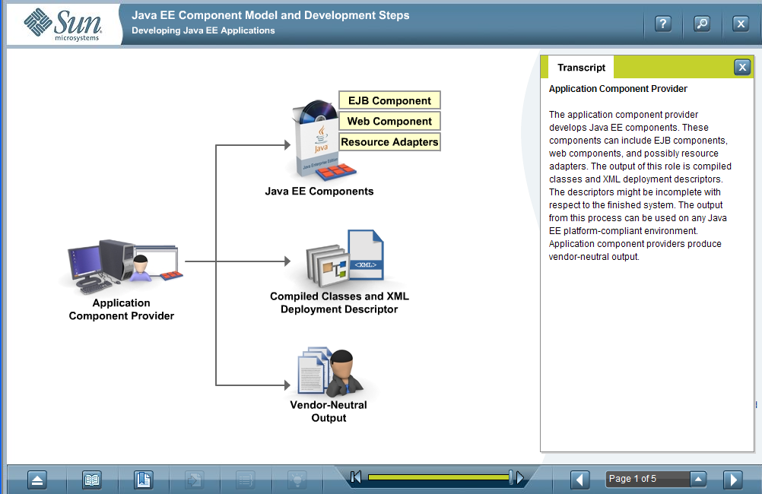
Application Component Provider
Notes:
The application provider develops J2EE components. These components can include EJB components, web components and possibly resource adapters. The output of this role is compiled classes and XML deployment descriptors. The descriptors might be incomplete with respect to the finished system. The output from this process can be used on any J2EE platform-compliant environment. Application component providers produce vendor-neutral output.

Slide 38
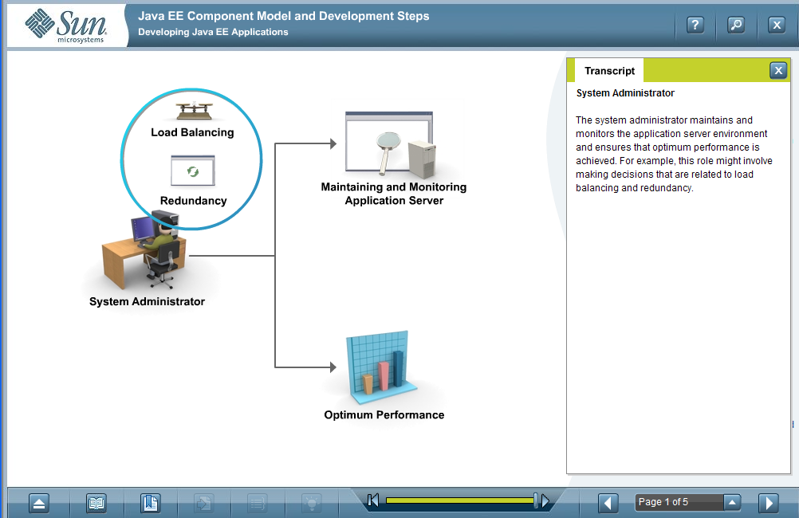
System Administrator
Notes:
The system administrator maintains and monitors the application server environment and ensures that optimum performance is achieved. For example, this role might involve making decisions that are related to load balancing and redundancy.

Slide 39
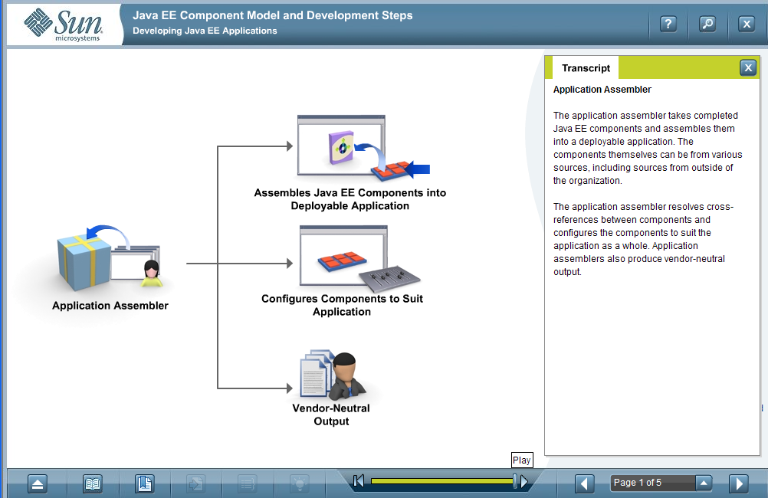
Application Assembler
Notes:
The application assembler takes completed J2EE components and assembles them into a deployable application. The components themselves can be from various sources, including sources from outside of the organization.
The application assembler resolves cross-reference between components and configures the components to suit the application as a whole. Application assemblers also produce vendor-neutral output.

Slide 40
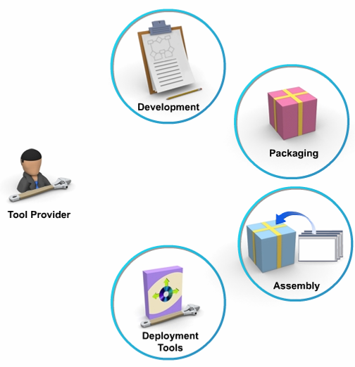
Tool Provider
Notes:
The tool provider implements development, packaging, assembly, and deployment tools. The standard-based nature of the J2EE specification allows a developer to use tools from third-party tool providers if they so desire.

Slide 41
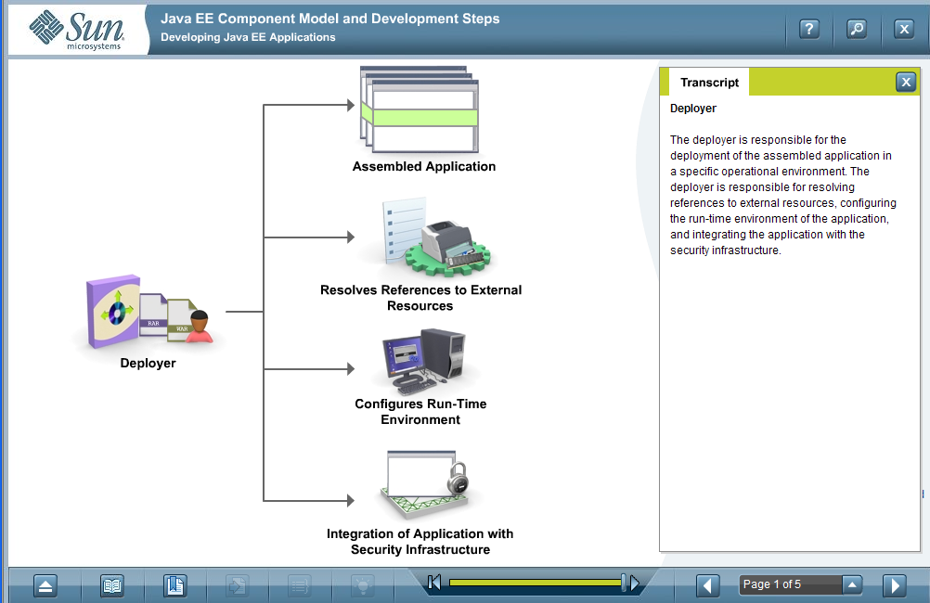
Deployer
Notes:
The deployer is responsible for the deployment of the assembled application in a specific operational environment. The deployer is responsible for resolving reference to external resources, configuring, the run-time environment of the application, and integrating the application with the security infrastructure.

Slide 42
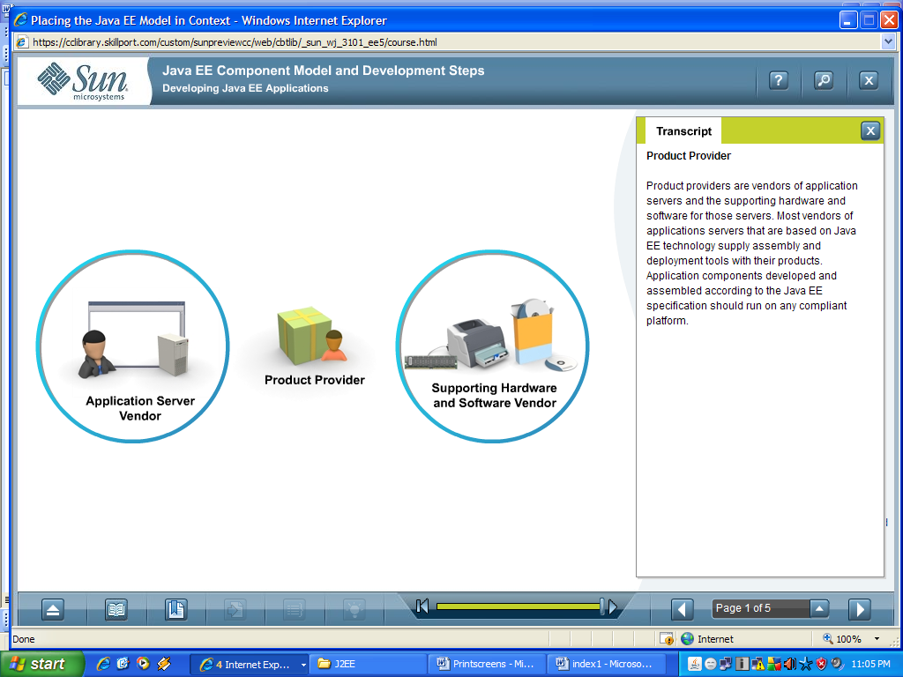
Product Provider
Notes:
Product providers are vendors of application servers and the supporting hardware and software for those servers. Most vendors of applications servers that are based on J2EE technology supply assembly and deployment tools with their products. Application components developed and assembled according to the J2EE specification should run on any compliant platform.

Slide 43
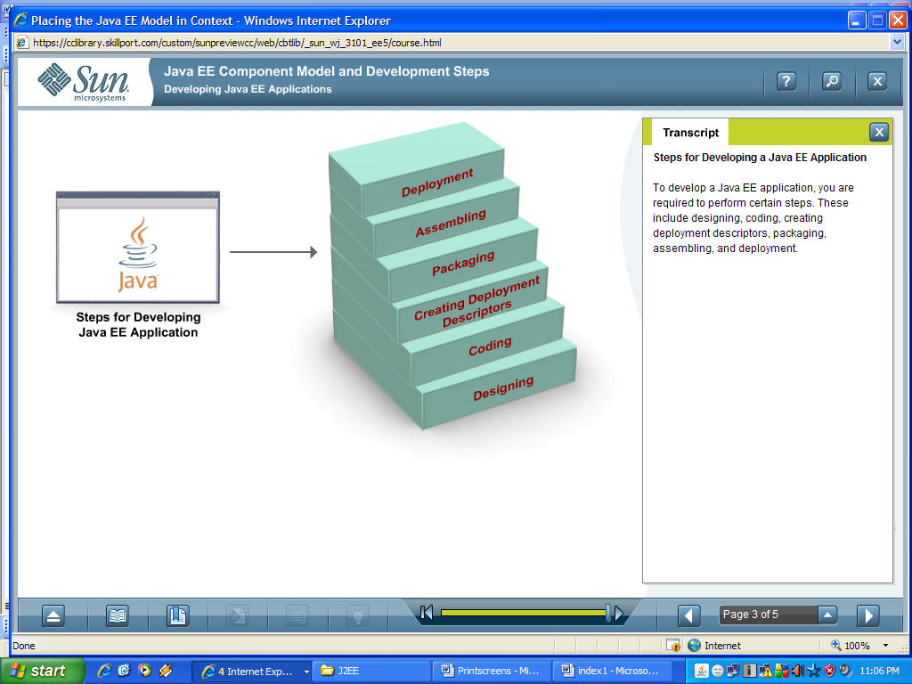
Steps for Developing J2EE Applications
Developing J2EE application involves following steps:
  Designing
  Coding
  Creating deployment descriptor
  Packaging
  Assembling
  Deployment

Slide 44

Summary
In this session, we have covered,
  What is J2EE ?
  The J2EE tiers
  Enterprise Application
  J2EE Components
  J2EE Roles

Slide 45
Thank You

